Slide 1

Innovation Exchange
April 2021
OMB Updates: 2 CFR Revisions and M-21-20
Office of Management and Budget

Slide 2
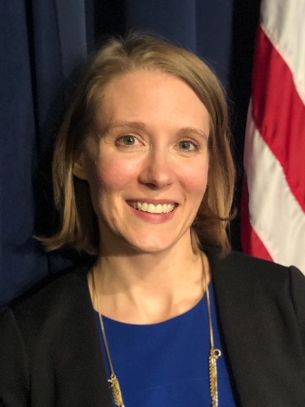


Speaker Introductions
Rhea Hubbard is a Senior Policy Analyst with the Office of Management and Budget (OMB), Office of Federal Financial Management (OFFM). She contributes to government-wide initiatives to improve Federal financial assistance policies, processes, and systems. In this role, she engages with relevant Government and non-Federal stakeholders on key issues to foster more efficient and effective Federal management. She is currently the OMB staff lead for the Results-Oriented Accountability Cross-Agency Priority Goal under the President’s Management Agenda. She started her decade long Federal career in grants management operations and later transitioned into policy. She is passionate about solving long-standing grants management challenges to ensure successful results for the American taxpayer while finding opportunities to alleviate recipient burden. Rhea has a Master of Public Policy Degree from American University and a Bachelor in Arts Degree in Psychology from the University of Missouri – Columbia.
Gil Tran is a Senior Policy Analyst with the Office of Management and Budget (OMB), Office of Federal Financial Management (OFFM). His main responsibilities are to develop and analyze policies and standards for cost principles and audit requirements for federal programs, including the Uniform Guidance at 2 CFR Part 200 – Uniform Administrative Requirements, Cost Principles, and Audit requirements for Federal Awards, for which he serves as the point of contact for all Federal agencies on its implementation and interpretation. He also serves a liaison to the audit communities, including GAO and the IG Offices for the implementation of the Single Audit Act. He joined OFFM in February 1995. Gil received a Bachelor of Science degree in Accounting from George Mason University, Virginia. He is a Certified Public Accountant. He chaired the Diversity Committee for the U.S. Tennis Association (Mid–Atlantic Section).
Alyssa Cogen is a Pathways Graduate Student Trainee with the Office of Management and Budget (OMB), Office of Federal Financial Management. She is currently pursuing a Masters of Public Administration, with a concentration in Non-Profit Management, at the George Washington University Trachtenberg School of Public Policy and Public Affairs. Alyssa has a degree in Human Ecology from College of the Atlantic, in Bar Harbor, ME. Before joining OFFM, Alyssa worked in the non-profit and philanthropy sectors. She has experience with grant writing and private foundation management.

Slide 3
Grants Overview

Slide 4

Revisions to 2 CFR – Uniform Guidance
Scopes of the revision:
Supporting of implementation of the President’s Management Agenda and administration priorities
Meeting statutory requirements and to align with other authoritative source requirements
Clarifying existing requirements
Effective Dates
200.216, 200.340, 200.471 – August 13, 2020
Other Sections – November 12, 2020

Slide 5
Major Revisions to 2 CFR
Support the President’s Management Agenda Results-Oriented Accountability for Grants CAP Goal and other Administration priorities
Some revisions include (see preamble for more details):
Emphasizing stewardship and results-oriented accountability for grant program results (§§ 200.102(d), 200.202, 200.205, 200.207, 200.211(a), 200.211(c)(1)(iv), 200.211(c)(1)(v), 200.211(c)(2), §200.301, 200.339(a)(2), Appendix I (A) & (B))
Standardizing terminology to implement standard data elements (§§ 200.1, 200.207, 200.301, 200.328(c)(2))
Making indirect cost rates transparent (§ 200.414(h))
Strengthening merit review requirements for discretionary grants (§ 200.205)
Eliminating references to agency non-authoritative guidance (§ 200.105)
Clarifying the termination provisions (§ 200.340)

Slide 6
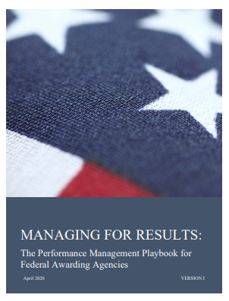
Grant Performance Management
What do we mean by Performance Management?
“The use of goals, measurement, evaluation, analysis and data-driven reviews to improve the effectiveness and efficiency of agency operations”
Why does this matter to me?
Recent revisions to Title 2 of the Code of Federal Regulations
How can I improve program and project performance management to focus on results?
Reference: Managing for Results:
The Performance Management Playbook
for Federal Awarding Agencies

Slide 7
Federal Grants Lifecycle - Performance
Phase 4
Post-Award Management
and Closeout
Phase 2
Pre-Award Management
Phase 1
Program Administration
Phase 3
Award Management
Phase 5
Program Oversight

Slide 8

Procurement “Claw” (Section 200.320)
ALEXA, please order a scientific bioprocessing centrifuge for our NIH grant
Sure! The average price of a bioprocessing centrifuge is $20,000 so I will need at least two quotes. See Tran’s Bear Claw!

Slide 9
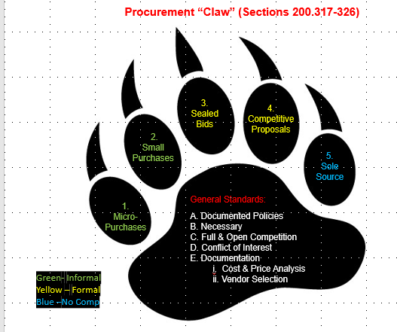
Major Revisions to 2 CFR

Slide 10
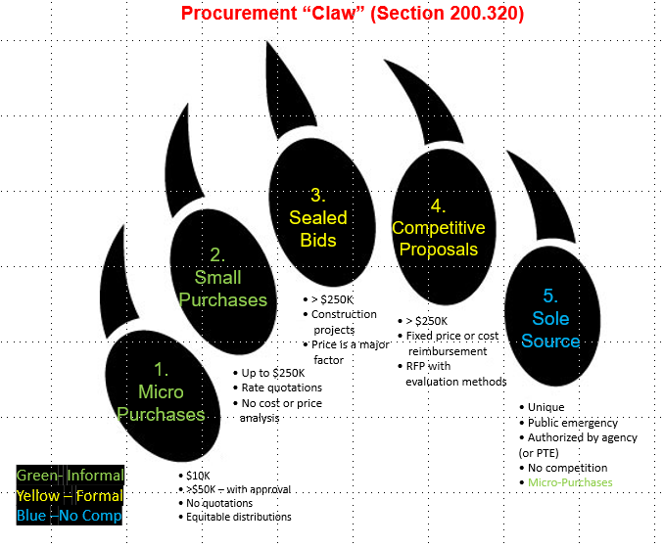
Major Revisions to 2 CFR

Slide 11



Major Revisions to 2 CFR
Meet statutory requirements and align with other authoritative sources
Some revisions include (see preamble for more details) aligning with:
The Federal Acquisition Regulation (FAR) and the 2017 and 2018 National Defense Authorization Acts (NDAA) to raise the micro-purchase threshold from $3,500 to $10,000 and the simplified acquisition threshold from $100,000 to $250,000 (§§ 200.319, 200.320)
The 2019 NDAA section 889, Prohibition on certain telecommunications and video surveillance services or equipment (§ 200.216)
The General Accepted Accounting Principles (GAAP), specifically the Government Accounting Statements Board (GASB) statement 68 and 45, related to pension costs and depreciation (§ 200.431)

Slide 12
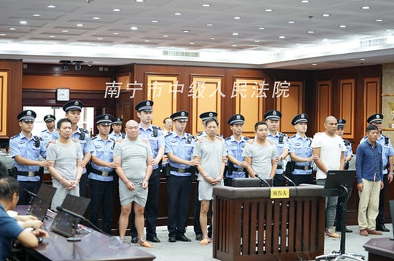
Revisions to 2 CFR
USA Today 10/25/19 – Case of Extreme Subcontracting

Slide 13

Major Revisions to 2 CFR
Clarifying existing requirements
Some revisions include (see preamble for more details):
Codifying some frequently asked questions related to the prior release to 2 CFR (§§ 200.101, 200.332, 200.414)
Clarifying the responsibilities of the pass-through entity to address only a subrecipient’s audit findings related to their specific subaward (§ 200.332)
Clarifying the documentation requirement for using the de minimis indirect cost rate (§ 200.414)

Slide 14
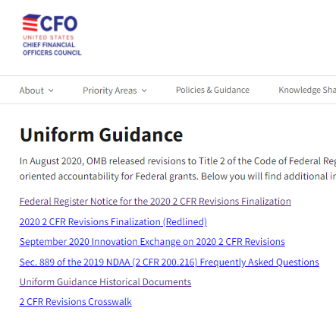
Major Revisions to 2 CFR
Frequently Asked Questions
Additional Information on the 2 CFR Revisions
https://www.cfo.gov/financial-assistance/resources/uniform-guidance.html
https://www.cfo.gov/grants-training/

Slide 15
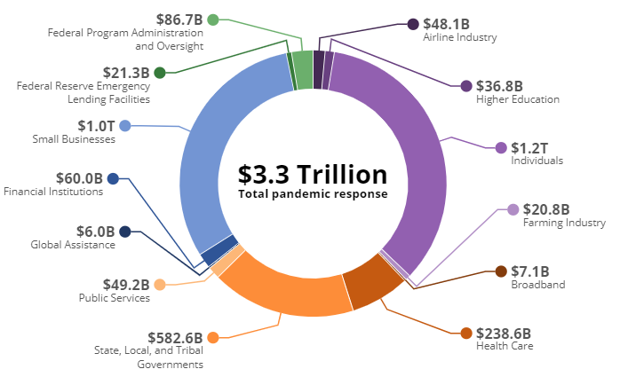
American Rescue Plan Act of 2021 (ARPA)
6th COVID Relief Act – P.L.117-2 (P.L. 116-123, 116-127,116-136, 116-139, 116-260)
$1.9 Trillion Dollars
Assistance to Individuals - $400 Billion
State and Local Support - $362 Billion
Unemployment Insurance - $246 Billion
Health and Vaccines – $228 Billion
Child Care, Head Start - $194 Billion
Other Provisions (Schools) -$ 173 Billion
Tax Credits for Organizations - $143
Civic and Community Infrastructure - $85 Billion
Small Business Administration Programs - $84 Billion
https://www.pandemicoversight.gov/

Slide 16
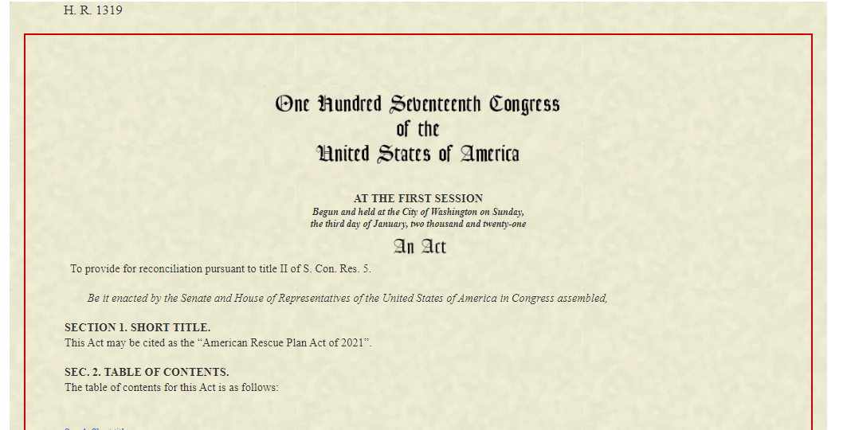
American Rescue Plan Act of 2021 (ARPA)
State, Local, and Tribal Government Support – $362 billion
Assistance to State Governments and District of Columbia – $195.3 billion
Assistance to Local Governments – $130.2 billion
Assistance to Tribal Governments – $20 billion
Assistance to Territorial Governments – $4.5 billion
Coronavirus Capital Projects Fund – $10 billion (A minimum of $100 million will go to each state, Puerto Rico, and the District of Columbia)
Local Assistance and Tribal Consistency Fund – $2 billion to counties and tribal governments that face a negative revenue impact due to a federal program or changes to a federal program.
Pandemic Premium Pay –up to $13 per hour extra may be paid to workers “needed to maintain continuity of operations of essential critical infrastructure sectors and additional sectors” as designated by a governor or tribal government.

Slide 17
American Rescue Plan Act of 2021 (ARPA)
Some Unusual Assistance Programs
Restaurants – $28.6 billion
Rental Assistance – $22.0 billion
School Re-Openings - $125 Billion
Minority Farmers - $5 Billion
Music Venues, Event Venues, Cinema Theaters- $1.25 Billion
Libraries, Museums - $470 Million
Airports, Airlines - $30 Billion
OMB M-21-20 - March 19, 2021
Equity-Oriented Results for Financial Assistance
Subrecipient reporting requirements apply
Appendix 2
-2 CFR applies to ALL recipients
-Higher Risk program designation
Appendix 3 –12 Flexibilities
-Single Audit submission extension – 6 Months
“We have to prove to the American people that their government can deliver for them, and do it without waste or fraud;
We're going to have to stay on top of every dollar spent through the American Rescue Plan.”
President Biden, March 15, 2021

Slide 18
M-21-20 Equity-Oriented Results Appendix 2
Achieving More Equity-Oriented Results for Financial Assistance
Program Planning and Design
Public Availability of Notice of Funding Opportunities (NOFOs)
Performance Reporting
Risk Management
Case-by-Case Exceptions
Innovative Funding Approaches
Procurement of Common or Shared Goods and Services (Including IT)
Financial Assistance Awards for For-Profit Organizations
Other Types of Federal Financial Assistance
Use of Single Audit to Drive Accountability and Transparency
For more resources, agencies may leverage Managing for Results: The Performance Management Playbook for Federal Awarding Agencies and other items at https://www.cfo.gov/financial-assistance
ARP Implementation Questions: ARP.implementation@omb.eop.gov
Risk
Results
Transparency
Accountability
Performance
Equity
Innovation

Slide 19
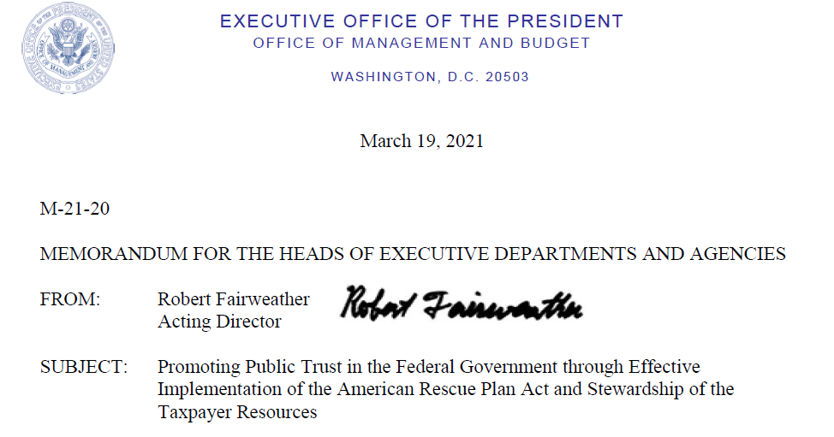

M-21-20 Flexibilities – Appendix 3
The Twelve Flexibilities – Reduce Burden
SAM Registration
NOFO Publication
Pre-award Costs
No-Cost Extension
Abbreviated Non-Competitive Continuation
Prior Approval Requirements
Procurement Standards
Extension of Financial and Other Reporting
Single Audit Extension
Application Deadlines
Closeout Extension
Physical Inventories
M-21-20 Versus M-20-17
- Salaries and Other Project costs
- Canceled Events, Travel costs
- IDC Rate Extension
+ Single Audit Extension
+ Physical Inventories

Slide 20

OMB Guidance and Resource Highlights
Presidential Directives:
EO - Advancing Racial Equity and Support for Underserved Communities through the Federal Government – January 20,2021
EO - Restoring Trust in Government through Scientific Integrity and Evidence-Based Policymaking – January 27, 2021
Recent Guidance Highlights:
2 CFR 200 (Revised August 12, 2020)
M-21-20: Promoting Public Trust in the Federal Government through Effective Implementation of the American Rescue Plan Act and Stewardship of the Taxpayer Resources – March 19, 2021
Resources:
Managing for Results: The Performance Management Playbook for Federal Awarding Agencies

Slide 21

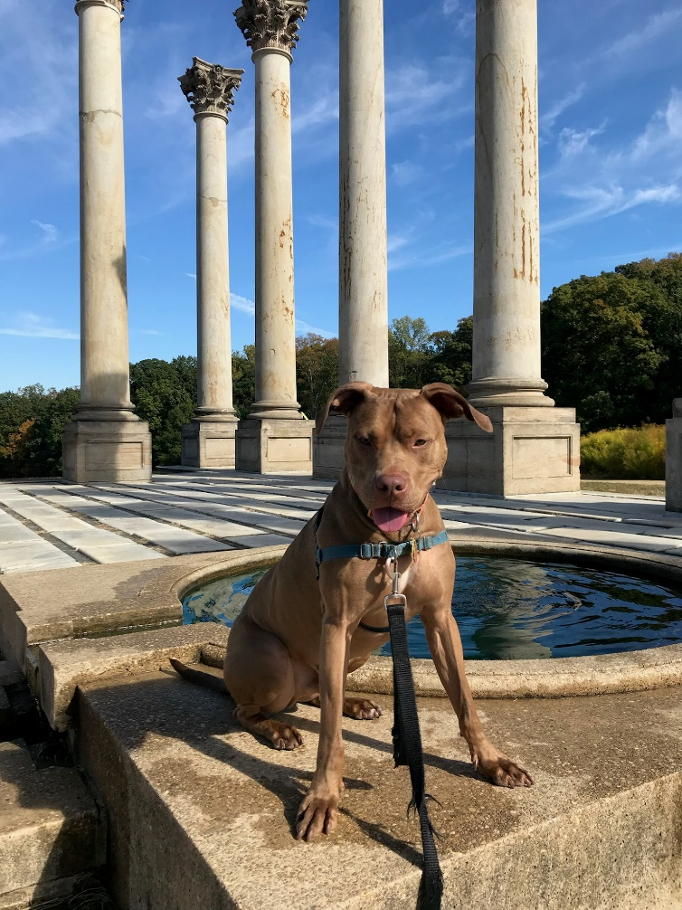

Contact OMB with Questions
We are here to help!
Email us your questions: GrantsTeam@omb.eop.gov

